Slide 1

SOKOINE UNIVERSITY OF AGRICULTURE
School of Engineering and Technology | Department of Agricultural Engineering
AEN 214: INTRODUCTION TO ELECTRONICS — LECTURE 7
Number Systems & Digital Arithmetic
Binary, Octal, Hexadecimal, Two's Complement, BCD, Gray Codes & Tractor CAN-Bus Telemetry
Course Instructor: Dr. Kadeghe Goodluck Fue, PhD, P.Eng (T)
Electronics & Precision Agriculture Laboratory | Academic Year 2025/2026 | Sokoine University of Agriculture
Sokoine University of Agriculture | School of Engineering & Technology | Department of Agricultural Engineering
Slide 1 of 26

Slide 2
AEN 214: INTRODUCTION TO ELECTRONICS
Lecture 7 Learning Outcomes & Analytical Scope
• Master Positional Radix Systems: Decimal (base 10), Binary (base 2), Octal (base 8), and Hexadecimal (base 16).
• Execute Inter-Base Conversion Algorithms: Repeated division/multiplication and direct nibble/byte grouping.
• Perform Binary Arithmetic: Multi-bit addition, binary subtraction, binary multiplication, and binary division.
• Understand Signed Integer Representation: Signed-magnitude, 1's complement, and 2's complement encoding.
• Analyze Two's Complement Subtraction & Overflow: Subtraction via addition, sign bit extension, and hardware overflow detection.
• Differentiate Specialized Digital Codes: Binary Coded Decimal (BCD), Excess-3 code, and Reflected Gray code.
• Apply Digital Codes to Agriculture: Rotary shaft optical encoders, wind direction vanes, and ISO 11783 (ISOBUS) CAN frames.
Sokoine University of Agriculture | School of Engineering & Technology | Department of Agricultural Engineering
Slide 2 of 26

Slide 3
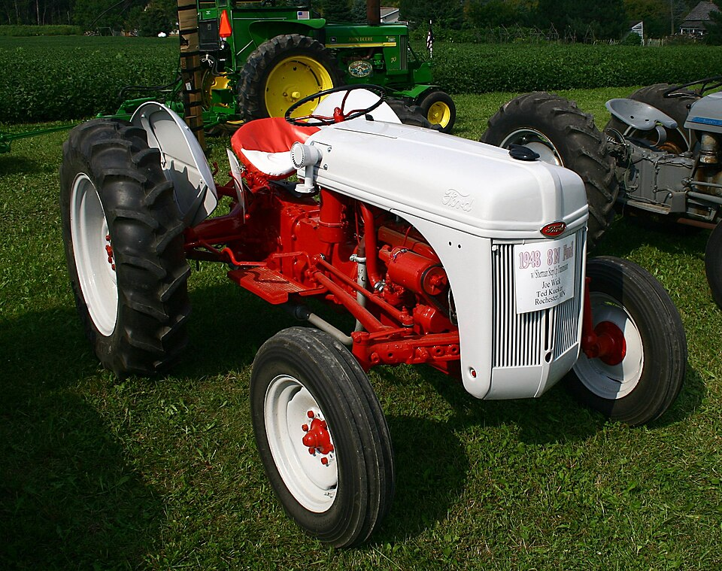
AEN 214: INTRODUCTION TO ELECTRONICS
The Digital Domain in Agricultural Engineering
• From Analog Transducers to Digital Bits: Microcontrollers inside tractors, harvesters, and drones compute strictly in binary.
• High-Speed In-Field Telemetry: Soil moisture networks, weather stations, and drone LiDAR stream gigabytes of digital words.
• Sensor Calibration Precision: ADCs convert physical analog voltages (soil salinity, canopy temperature) into 10-bit or 16-bit binary words.
• Precision Harvester Yield Monitors: Optical shaft encoders on grain clean elevators use Gray code to eliminate angular measurement errors.
• Standardized Farm Bus Networks: ISO 11783 (ISOBUS) connects tractor displays to implements via hexadecimal CAN-bus message frames.
Sokoine University of Agriculture | School of Engineering & Technology | Department of Agricultural Engineering
Slide 3 of 26

Slide 4
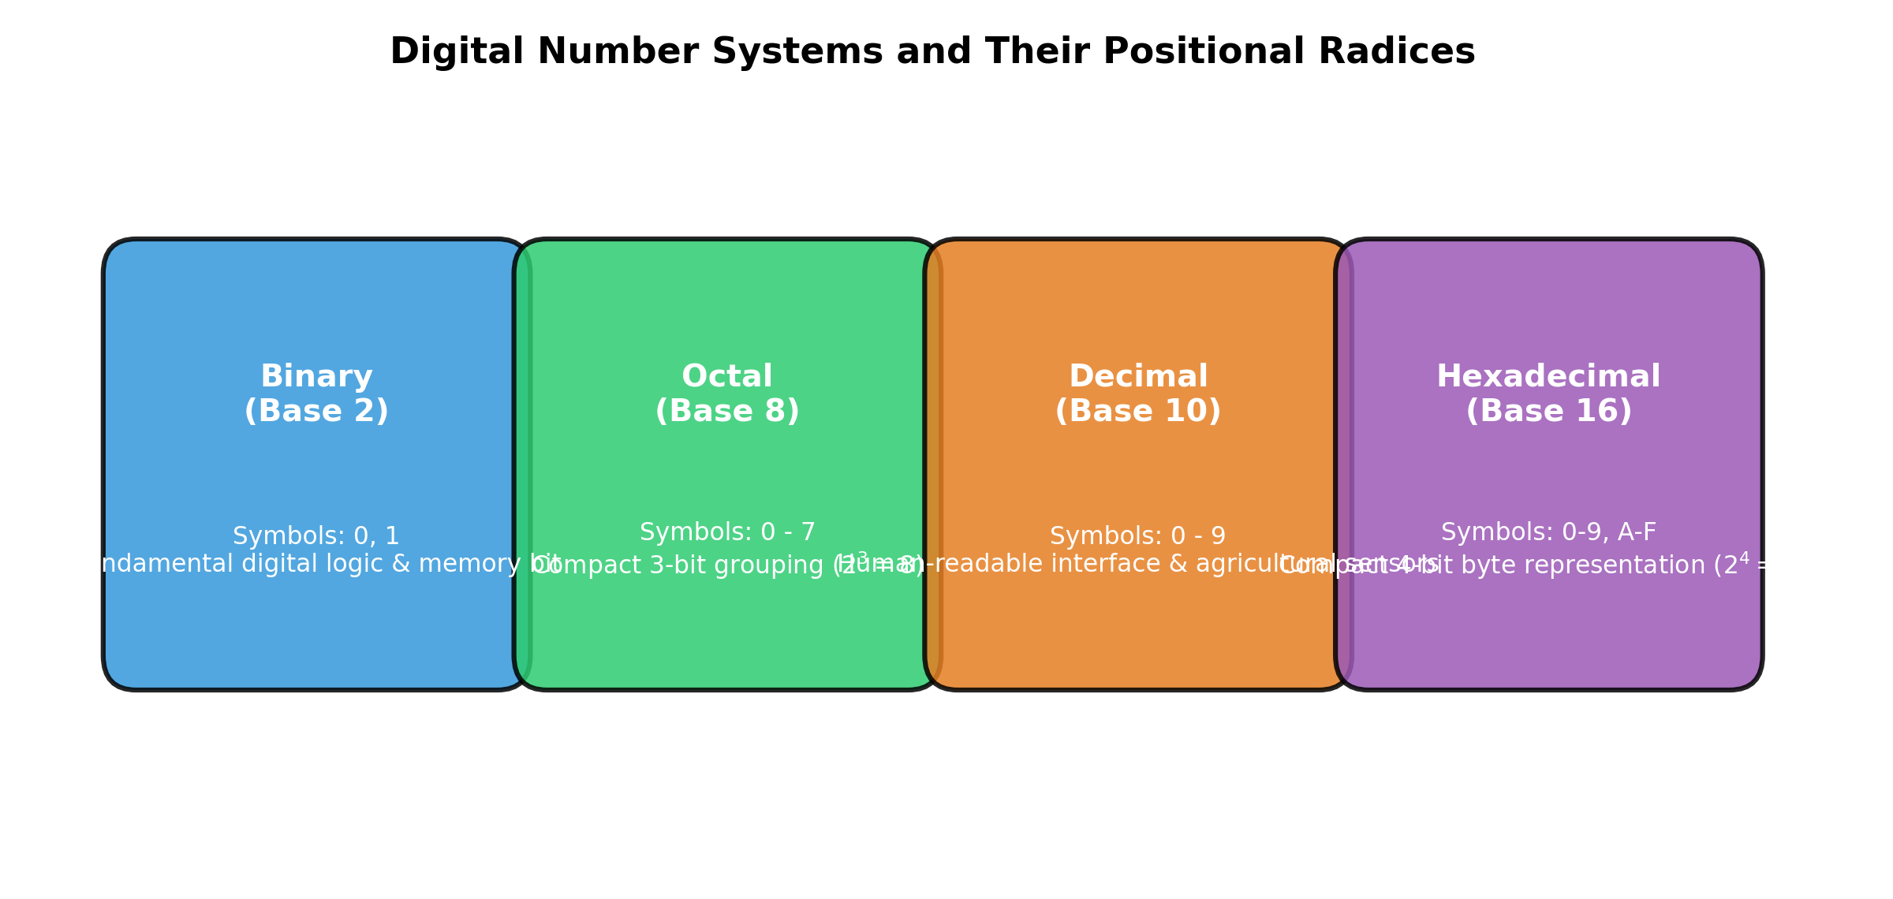
AEN 214: INTRODUCTION TO ELECTRONICS
Positional Number Systems: Radix & Positional Weight
• General Radix Formulation: A number N in base r is evaluated by: N = Sum [ d_i · r^i ], where d_i are valid digits (0 <= d_i < r).
• Radix-10 (Decimal): Digits {0, 1, ..., 9}; Weights: 10^3 (thousands), 10^2 (hundreds), 10^1 (tens), 10^0 (units), 10^-1 (tenths).
• Radix-2 (Binary): Digits {0, 1}; Weights: 2^7 (128), 2^6 (64), 2^5 (32), 2^4 (16), 2^3 (8), 2^2 (4), 2^1 (2), 2^0 (1).
• Radix-8 (Octal): Digits {0, 1, 2, 3, 4, 5, 6, 7}; Used for compact human representation of 3-bit binary clusters.
• Radix-16 (Hexadecimal): Digits {0–9, A, B, C, D, E, F}; Used for byte-level human representation (1 Hex digit = exactly 4 binary bits).
Sokoine University of Agriculture | School of Engineering & Technology | Department of Agricultural Engineering
Slide 4 of 26

Slide 5
AEN 214: INTRODUCTION TO ELECTRONICS
Inter-Base Conversion Algorithms
• Decimal-to-Binary Integer Conversion: Successive division by 2; remainders read from bottom (MSB) to top (LSB).
• Decimal-to-Binary Fractional Conversion: Successive multiplication by 2; integer carries read from top to bottom.
• Direct Binary-to-Hexadecimal Mapping: Group binary bits into clusters of 4 (nibbles) starting from binary point; replace with Hex digit.
• Direct Hexadecimal-to-Binary Mapping: Expand each individual Hex digit into its equivalent 4-bit binary nibble.
• Octal Conversions: Group binary bits into clusters of 3; each octal digit corresponds exactly to 3 binary bits (e.g. 7_8 = 111_2).
Sokoine University of Agriculture | School of Engineering & Technology | Department of Agricultural Engineering
Slide 5 of 26

Slide 6
AEN 214: INTRODUCTION TO ELECTRONICS
Fundamental Binary Arithmetic Operations
• Binary Addition Axioms: 0 + 0 = 0; 0 + 1 = 1; 1 + 0 = 1; 1 + 1 = 0 with Carry of 1 (10_2); 1 + 1 + 1 = 1 with Carry of 1 (11_2).
• Columnar Multi-Bit Addition: Add bit pairs along with incoming carry bit; propagate carry to next higher significance bit.
• Binary Subtraction Axioms: 0 - 0 = 0; 1 - 0 = 1; 1 - 1 = 0; 0 - 1 = 1 with Borrow of 1 from adjacent higher bit.
• Hardware Disadvantage of Subtraction: Building separate binary subtractor circuits with borrow logic requires complex, bulky hardware.
• The Complement Solution: Digital microprocessors perform all subtractions using addition via **Two's Complement** arithmetic!
Sokoine University of Agriculture | School of Engineering & Technology | Department of Agricultural Engineering
Slide 6 of 26

Slide 7
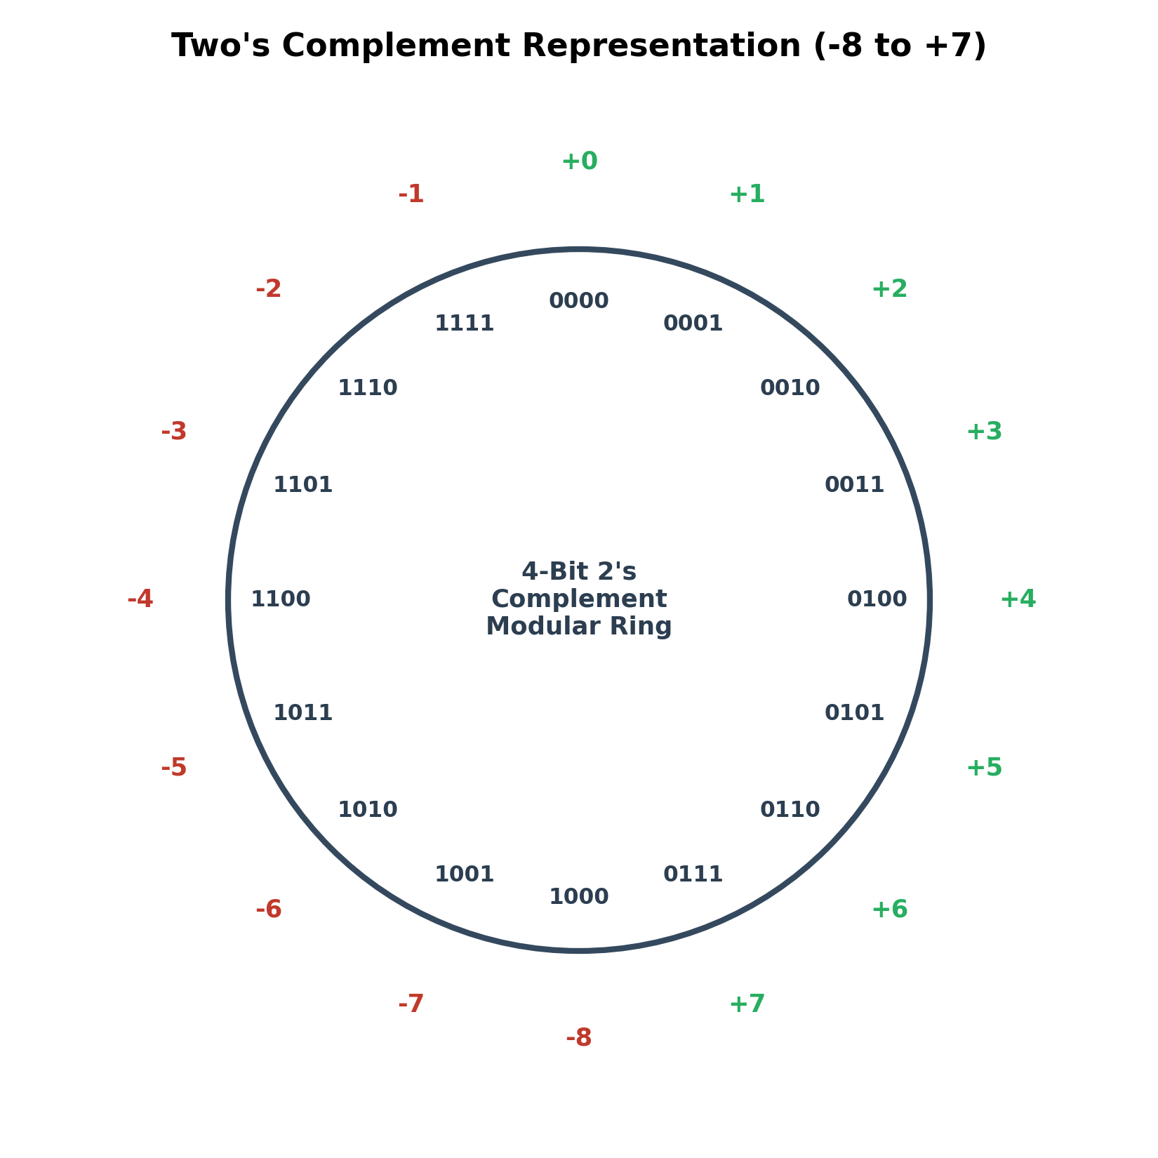
AEN 214: INTRODUCTION TO ELECTRONICS
Signed Integer Representations: Sign-Magnitude to 2's Complement
• Signed-Magnitude Representation: Most Significant Bit (MSB) is sign bit (0 = Positive, 1 = Negative); remaining bits are magnitude.
• Sign-Magnitude Flaws: Two distinct zeros (+0 and -0) confuse ALU comparison logic; requires separate adder and subtractor hardware.
• One's Complement: Invert every bit of the number (0 -> 1, 1 -> 0); still suffers from dual zeros (+0 = 0000_2, -0 = 1111_2).
• Two's Complement: Invert every bit (1's complement) and ADD 1: B_{2's} = /B + 1.
• Two's Complement Supremacy: Has a unique zero (00000000_2); allows addition and subtraction to use the EXACT same adder hardware!
• Dynamic Range for N bits: -2^(N-1) to + (2^(N-1) - 1). For 8 bits: -128 to +127.
Sokoine University of Agriculture | School of Engineering & Technology | Department of Agricultural Engineering
Slide 7 of 26

Slide 8
AEN 214: INTRODUCTION TO ELECTRONICS
Two's Complement Subtraction & Overflow Detection
• Subtraction Rule: To compute A - B, calculate: Result = A + B_{2's} = A + (/B + 1).
• End-Around Carry Rule: Any carry bit generated beyond the MSB is simply discarded; the remaining N bits are the mathematically correct result.
• Arithmetic Overflow Hazard: Occurs when the result of adding two numbers exceeds the representable dynamic range of the N-bit register.
• Overflow Conditions: Adding two positive numbers yields a negative result (MSB = 1), OR adding two negative numbers yields a positive result (MSB = 0).
• Hardware Overflow Detection Rule: An overflow occurs if and only if: C_in(MSB) XOR C_out(MSB) = 1 (Carry into MSB differs from carry out).
• ALU Flag: Microcontroller hardware automatically sets the 'V' (Overflow) status flag, triggering software safety traps.
Sokoine University of Agriculture | School of Engineering & Technology | Department of Agricultural Engineering
Slide 8 of 26

Slide 9
AEN 214: INTRODUCTION TO ELECTRONICS
Worked Engineering Example 1: Signed Two's Complement Subtraction with Overflow Check
PROBLEM SPECIFICATION & AGRICULTURAL CONTEXT:
A digital fertilizer injection rate computer on a Massey Ferguson tractor calculates difference Delta Q = Q_actual - Q_target in 8-bit signed two's complement. If actual delivery is Q_actual = +58 Liters/ha and target is Q_target = +85 Liters/ha: (a) Express +58 and +85 in 8-bit binary, (b) Find the two's complement of +85, (c) Perform the subtraction via addition (58 - 85), (d) Check for arithmetic overflow.
STEP-BY-STEP MATHEMATICAL SOLUTION & VERIFICATION:
1. Convert to 8-Bit Binary:
• +58 = 32 + 16 + 8 + 2 = 00111010_2.
• +85 = 64 + 16 + 4 + 1 = 01010101_2.
2. Form Two's Complement of +85 (-85):
• Take 1's complement: Invert bits of 01010101_2 -> 10101010_2.
• Add 1: 10101010_2 + 1 = 10101011_2 (Represents -85 in 2's complement).
3. Execute Addition (A + B_{2's}):
00111010 (+58)
+ 10101011 (-85)
= 11100101
4. Verify Magnitude & Sign of Result (11100101_2):
• MSB is '1', indicating a negative quantity.
• Invert and add 1 to find magnitude: 11100101 -> 00011010 + 1 = 00011011_2 = 16 + 8 + 2 + 1 = 27_10.
• Result = -27 Liters/ha (Correct: 58 - 85 = -27).
5. Overflow Check: Adding positive (+58) and negative (-85) numbers CANNOT cause overflow; C_in(MSB)=0, C_out(MSB)=0 -> V=0.
Sokoine University of Agriculture | School of Engineering & Technology | Department of Agricultural Engineering
Slide 9 of 26

Slide 10
AEN 214: INTRODUCTION TO ELECTRONICS
Binary Coded Decimal (BCD 8421 Code)
• Concept: Encodes each decimal digit (0 through 9) into its separate 4-bit binary equivalent.
• Direct Decimal Mapping: 0=0000, 1=0001, 2=0010, ..., 8=1000, 9=1001. Digits 1010_2 through 1111_2 (10 to 15) are INVALID BCD states.
• Agricultural Instrument Displays: Used in weighing scales, digital grain moisture meters, and milking parlor rate displays.
• BCD Addition Rule: Add standard binary nibbles. If a nibble sum exceeds 9 (1001_2) OR if a nibble carry occurs: ADD 6 (0110_2) to correct!
• BCD Correction Mechanics: Adding 6 skips the 6 invalid 4-bit states, forcing the correct decimal carry into the next higher decade.
• Packed vs Unpacked BCD: Packed BCD stores two decimal digits per 8-bit byte (e.g. '74' = 0111 0100_2); maximizes memory density.
Sokoine University of Agriculture | School of Engineering & Technology | Department of Agricultural Engineering
Slide 10 of 26

Slide 11
AEN 214: INTRODUCTION TO ELECTRONICS
Unit-Distance Reflected Gray Code & Optical Encoders
• The Race Condition Vulnerability: In standard binary, advancing from 3 (011_2) to 4 (100_2) requires THREE bits to change simultaneously.
• Mechanical Alignment Skew: Mechanical tolerances cause bits to switch at slightly different nanoseconds, producing momentary false readings (e.g. 7 or 0).
• The Gray Code Solution: Unit-distance code where adjacent numerical values differ by **EXACTLY ONE BIT** throughout the entire sequence.
• Binary-to-Gray Conversion Algorithm: Gray MSB = Binary MSB; Subsequent Gray bits: G_i = B_i XOR B_{i+1}.
• Gray-to-Binary Conversion Algorithm: Binary MSB = Gray MSB; Subsequent Binary bits: B_i = B_{i+1} XOR G_i.
• Tractor & Combine Encoders: Mandatory for optical shaft encoders measuring wheel steering angle and combine threshing cylinder speed.
Sokoine University of Agriculture | School of Engineering & Technology | Department of Agricultural Engineering
Slide 11 of 26

Slide 12
AEN 214: INTRODUCTION TO ELECTRONICS
Worked Engineering Example 2: Binary-to-Gray Conversion for Combine Harvester Header
PROBLEM SPECIFICATION & AGRICULTURAL CONTEXT:
An absolute optical shaft encoder monitoring the cutterbar tilt angle on a combine harvester in Morogoro outputs an 8-bit position word. At a critical tilt angle, the raw binary reading is B = 10110110_2 (182_10). To prevent race-condition glitch errors during fast tilting: (a) Convert binary word B to its 8-bit Gray code G, (b) Demonstrate the single-bit transition property if the tilt increments to B = 10110111_2 (183_10).
STEP-BY-STEP MATHEMATICAL SOLUTION & VERIFICATION:
1. Binary Word: B = B_7 B_6 B_5 B_4 B_3 B_2 B_1 B_0 = 1 0 1 1 0 1 1 0_2.
2. Apply Binary-to-Gray Formula (G_i = B_i XOR B_{i+1}; G_7 = B_7):
• G_7 = B_7 = 1
• G_6 = B_7 XOR B_6 = 1 XOR 0 = 1
• G_5 = B_6 XOR B_5 = 0 XOR 1 = 1
• G_4 = B_5 XOR B_4 = 1 XOR 1 = 0
• G_3 = B_4 XOR B_3 = 1 XOR 0 = 1
• G_2 = B_3 XOR B_2 = 0 XOR 1 = 1
• G_1 = B_2 XOR B_1 = 1 XOR 1 = 0
• G_0 = B_1 XOR B_0 = 1 XOR 0 = 1
Gray Code Result G = 11101101_Gray.
3. Next Increment B = 10110111_2 (183_10):
• G_0 = B_1 XOR B_0 = 1 XOR 1 = 0 (only bit G_0 flips from 1 to 0!).
• All other 7 bits remain identical: G_next = 11101100_Gray.
4. Verification: Exactly ONE bit toggled during the numerical increment; eliminates mechanical contact race errors completely.
Sokoine University of Agriculture | School of Engineering & Technology | Department of Agricultural Engineering
Slide 12 of 26

Slide 13
AEN 214: INTRODUCTION TO ELECTRONICS
Alphanumeric Coding: ASCII, UTF-8 & Farm Telemetry
• American Standard Code for Information Interchange (ASCII): 7-bit binary code representing 128 characters (letters, numbers, control symbols).
• ASCII Structure: '0' to '9' = 30_16 to 39_16; 'A' to 'Z' = 41_16 to 5A_16; 'a' to 'z' = 61_16 to 7A_16.
• Control Characters: CR (Carriage Return = 0D_16), LF (Line Feed = 0A_16), ACK (Acknowledge = 06_16), NAK (Negative Ack = 15_16).
• NMEA 0183 GPS Strings: Precision farming GPS receivers output ASCII sentences (e.g. '$GPGGA,...') over serial UART at 9,600 baud.
• Extended ASCII & UTF-8: 8-bit to 32-bit encodings supporting international characters and engineering symbols (e.g. °C, micro, Ohm).
Sokoine University of Agriculture | School of Engineering & Technology | Department of Agricultural Engineering
Slide 13 of 26

Slide 14
AEN 214: INTRODUCTION TO ELECTRONICS
ISO 11783 (ISOBUS) & Controller Area Network (CAN)
• The Agricultural Bus Standard: Standardizes electronic communication between tractors and mounted implements (sprayers, seeders, balers).
• Physical Layer: Differential voltage bus (CAN_H, CAN_L) operating at 250 kbps; twisted-pair with 120 Ohm termination resistors.
• 29-Bit Extended CAN Identifier: Structured into Priority (3 bits), Parameter Group Number (PGN, 18 bits), and Source Address (8 bits).
• Parameter Group Numbers (PGNs): Hexadecimal identifiers defining data payload (e.g. PGN 65265 / 00FEF1_16 = Vehicle Speed & Distance).
• Universal Terminal (UT): Allows any implement ECU to upload its graphical user interface directly to the virtual terminal in the tractor cab.
Sokoine University of Agriculture | School of Engineering & Technology | Department of Agricultural Engineering
Slide 14 of 26

Slide 15
AEN 214: INTRODUCTION TO ELECTRONICS
Worked Engineering Example 3: Decoding ISO 11783 (ISOBUS) Tractor Wheel Speed
PROBLEM SPECIFICATION & AGRICULTURAL CONTEXT:
An autonomous tractor ISOBUS CAN-bus datalogger captures a vehicle speed message frame with raw Hexadecimal payload: [ 4E 1F 00 00 FF FF FF FF ]. According to ISO 11783-7, Bytes 1 and 2 represent Wheel-Based Vehicle Speed encoded as a 16-bit unsigned integer with Little-Endian byte order (Least Significant Byte first), with a resolution of 1/1000 km/h per bit (0.001 km/h/bit) and zero offset. Calculate: (a) 16-bit hexadecimal speed word, (b) Decimal equivalent integer, (c) Tractor forward ground speed in km/h.
STEP-BY-STEP MATHEMATICAL SOLUTION & VERIFICATION:
1. Extract Bytes 1 and 2 from Payload: Byte 1 = 4E_16, Byte 2 = 1F_16.
2. Assemble Little-Endian 16-Bit Word (LSB first -> Byte 2 is MSB, Byte 1 is LSB):
Raw Hex Word = 1F 4E_16.
3. Convert Hexadecimal to Decimal Integer:
• 1F4E_16 = (1 · 16^3) + (15 · 16^2) + (4 · 16^1) + (14 · 16^0).
• = (1 · 4,096) + (15 · 256) + (4 · 16) + (14 · 1) = 4,096 + 3,840 + 64 + 14 = 8,014_10.
4. Apply ISOBUS Physical Scaling Factor (0.001 km/h per bit):
Tractor Speed = Raw Integer · Scaling Factor = 8,014 · 0.001 km/h = 8.014 km/h.
5. Agronomic Verification: 8.01 km/h is the optimal forward operating speed for tractor-mounted boom sprayers in weed control.
Sokoine University of Agriculture | School of Engineering & Technology | Department of Agricultural Engineering
Slide 15 of 26

Slide 16
AEN 214: INTRODUCTION TO ELECTRONICS
Digital Error Detection: Parity & CRC in Farm Telemetry
• Transmission Noise in Fields: High-power ignition noise and electric motor surges corrupt data bits on wireless farm telemetry links.
• Parity Bit: Appends a single bit to make total number of 1s either even (Even Parity) or odd (Odd Parity); detects single-bit errors.
• Parity Limitation: Fails to detect double-bit errors (e.g. two 0s flipped to 1s); inadequate for safety-critical tractor controls.
• Cyclic Redundancy Check (CRC): Treats data stream as a binary polynomial; divides by generator polynomial G(x) using modulo-2 arithmetic.
• CRC-15 in ISOBUS CAN: 15-bit CRC checksum appends to every CAN frame; detects burst errors up to 15 bits with 99.9999% reliability.
• Automatic Retransmission: If receiver CRC mismatch occurs, CAN hardware automatically drops frame and requests immediate retransmission.
Sokoine University of Agriculture | School of Engineering & Technology | Department of Agricultural Engineering
Slide 16 of 26

Slide 17
AEN 214: INTRODUCTION TO ELECTRONICS
Fixed-Point vs Floating-Point in Ag Microcontrollers
• Integer Microcontrollers: Low-cost 8-bit and 32-bit microcontrollers (e.g. ATmega328P, Cortex-M0) lack hardware Floating Point Units (FPUs).
• Floating-Point Penalty: Software floating-point emulation requires hundreds of CPU clock cycles, choking real-time sensor loops.
• Q-Format Fixed-Point Arithmetic: Binary point is fixed at a predetermined position; e.g. Q4.12 stores 4 integer bits and 12 fractional bits.
• Integer Scaling: Represent soil moisture (0.00% to 100.00%) as an integer scaled by 100 (0 to 10,000 counts); executes at single-cycle speed.
• IEEE 754 Floating-Point: Standard 32-bit single precision (1 sign bit, 8 exponent bits, 23 mantissa bits); used in high-end tractor autopilot GPS.
Sokoine University of Agriculture | School of Engineering & Technology | Department of Agricultural Engineering
Slide 17 of 26

Slide 18
AEN 214: INTRODUCTION TO ELECTRONICS
Analog-to-Digital Conversion (ADC) Quantization
• Continuous to Discrete: ADC samples continuous analog sensor voltages and quantizes them into N-bit discrete binary numbers.
• Resolution (Quantization Step Size Q): Q = V_ref / (2^N - 1) ≈ V_ref / 2^N (Volts/count).
• 10-Bit ADC (e.g. Arduino): 2^10 = 1,024 levels. For V_ref = 5.0 V, step size Q = 5.0 V / 1,024 = 4.883 mV.
• 12-Bit ADC (e.g. STM32, ESP32): 2^12 = 4,096 levels. For V_ref = 3.3 V, step size Q = 3.3 V / 4,096 = 0.8057 mV.
• Quantization Error: Inherent uncertainty of ± 0.5 Q; Can only be reduced by increasing ADC bit depth N.
• ADC Binary Output Word: Digital Code D = round[ (V_in / V_ref) · (2^N - 1) ].
Sokoine University of Agriculture | School of Engineering & Technology | Department of Agricultural Engineering
Slide 18 of 26

Slide 19
AEN 214: INTRODUCTION TO ELECTRONICS
Hardening Digital Busses Against Agricultural EMI
• Differential Signaling: CAN_H and CAN_L transmit inverted voltages; common-mode noise couples equally to both and is rejected by receiver.
• Shielded Twisted Pair (STP): 120 Ohm characteristic impedance cable prevents transmission line reflections; grounded foil shields EMI.
• Split Termination: Two 60 Ohm resistors with center-tap capacitor (4.7 nF to ground) suppress high-frequency common-mode noise.
• Opto-Isolated CAN Transceivers: Isolates 24V tractor electrical transients from sensitive 3.3V autopilot microcontroller boards.
• ESD Diode Arrays: PESD2CAN protection diodes clamp ±30 kV electrostatic discharges from dry grain augers and operators.
Sokoine University of Agriculture | School of Engineering & Technology | Department of Agricultural Engineering
Slide 19 of 26

Slide 20
AEN 214: INTRODUCTION TO ELECTRONICS
Tanzanian Field Case Study 1: Gray Code Optical Encoder Header Height Control
FIELD LOCATION & PROBLEM IDENTIFICATION
• Geographic Location: Kilombero Sugar Estate Sugarcane Combine Mechanization, Tanzania
Modern sugarcane combine harvesters operating at Kilombero experienced intermittent violent header gouging into the soil. At specific crop height positions, the cutterbar suddenly slammed into the ground, breaking tungsten blades and costing 8,500 USD in blade replacements and downtime.
SUA ENGINEERING SOLUTION & AGRONOMIC IMPACT
SUA agricultural engineers logged the raw 8-bit binary shaft encoder attached to the hydraulic height linkage. When the linkage transitioned from position 127 (01111111_2) to 128 (10000000_2), all eight bits were required to change state simultaneously. Mechanical vibration caused bit 7 to switch 18 microseconds ahead of the rest, creating a transient reading of 255 (full height), causing the ECU to slam the header down! Engineers replaced the sensor with an 8-bit Gray code encoder.
Measurable Performance Metrics:
✔ Completely eliminated cutterbar gouging glitches; zero broken blades across two seasons.
✔ Transition race condition eliminated since only ONE bit changes between adjacent states.
✔ Saved an estimated 32,000 USD in cutter blades, gearboxes, and harvester downtime.
Sokoine University of Agriculture | School of Engineering & Technology | Department of Agricultural Engineering
Slide 20 of 26

Slide 21
AEN 214: INTRODUCTION TO ELECTRONICS
Tanzanian Field Case Study 2: ISOBUS Telemetry Failure in Precision Rice Seeding
FIELD LOCATION & PROBLEM IDENTIFICATION
• Geographic Location: Mbarali Paddy Scheme Mechanized Seed Drilling, Mbeya, Tanzania
A precision 16-row pneumatic rice seed drill linked to a New Holland tractor cab terminal via ISO 11783 CAN-bus suffered intermittent seed metering cutoffs. The cab monitor displayed erroneous seed population drops, causing operators to unnecessarily halt planting in prime weather.
SUA ENGINEERING SOLUTION & AGRONOMIC IMPACT
Engineers discovered that the implement ECU was running an 8-bit microcontroller using software floating-point emulation to calculate seed spacing in meters. When seed metering frequency surpassed 80 pulses/second, floating-point execution delays triggered CAN buffer overruns, dropping vehicle speed message frames. Engineers converted all seed rate mathematics to 16-bit Q8.8 fixed-point integer arithmetic.
Measurable Performance Metrics:
✔ Seeding calculation execution time plummeted from 4.2 ms to 14 microseconds.
✔ CAN message frame loss dropped to 0.000%, eliminating all nuisance cab alarms.
✔ Seed planting uniformity reached 98.6% across 220 hectares of paddy fields.
Sokoine University of Agriculture | School of Engineering & Technology | Department of Agricultural Engineering
Slide 21 of 26

Slide 22
AEN 214: INTRODUCTION TO ELECTRONICS
Laboratory Bench Protocol: Binary Conversions & Logic Analyzer CAN-Bus Protocol
PRACTICAL LAB LEARNING OUTCOMES & BENCH REQUIREMENTS:
• Execute manual and computerized radix conversions between Binary, Hexadecimal, and BCD.
• Demonstrate 2's complement signed integer addition and verify arithmetic overflow flag on ALU.
• Capture Gray code shaft optical encoder output transitions on 8-channel logic analyzer.
• Decode raw Hexadecimal CAN-bus message packets captured from an agricultural tractor simulator.
STEP-BY-STEP PROTOTYPING & DIAGNOSTIC PROCEDURE:
Step 1: Write C program implementing integer-to-hexadecimal and 2's complement algorithms on Arduino UNO.
Step 2: Inject test additions (+120 + +15; -90 + -50); verify signed result and observe status register overflow flag.
Step 3: Connect optical rotary shaft encoder to breadboard; attach 8-channel USB logic analyzer to data outputs.
Step 4: Rotate encoder slowly; capture state transitions; verify that exactly one bit changes per angular increment.
Step 5: Connect CAN transceiver module to PC; transmit ISOBUS frame; decode PGN and data payload in Wireshark.
Sokoine University of Agriculture | School of Engineering & Technology | Department of Agricultural Engineering
Slide 22 of 26

Slide 23
AEN 214: INTRODUCTION TO ELECTRONICS
Diagnostic Troubleshooting in Digital Number Systems
• Arithmetic Overflow Ignored: Failing to check the overflow status bit results in large positive quantities turning negative (e.g. +127 + 1 = -128).
• Sign Extension Failure: Converting an 8-bit negative signed integer (e.g. 11110000_2) to 16-bit requires sign extension (11111111 11110000_2).
• Endianness Confusion: Big-Endian stores MSB first; Little-Endian stores LSB first (e.g. CAN bus, x86); swapping bytes corrupts telemetry data.
• Invalid BCD States: Feeding binary values 10 through 15 into a BCD display driver (74LS47) produces corrupted garbled display segments.
• Missing CAN Bus Termination: Omitting the 120 Ohm termination resistors at bus ends causes transmission line reflections, corrupting data frames.
Sokoine University of Agriculture | School of Engineering & Technology | Department of Agricultural Engineering
Slide 23 of 26

Slide 24
AEN 214: INTRODUCTION TO ELECTRONICS
Lecture 7 Self-Assessment & Upcoming Topics
SELF-ASSESSMENT & PROBLEM-SOLVING EXERCISES:
Q: Convert decimal number 347.625_10 into its exact equivalent in: (a) Binary, (b) Octal, (c) Hexadecimal.
Q: Represent -68_10 as an 8-bit signed integer using: (a) Signed-magnitude, (b) One's complement, (c) Two's complement.
Q: Perform the subtraction 45_10 - 78_10 using 8-bit two's complement arithmetic and verify the result.
Q: Explain why Gray code is preferred over standard binary code in agricultural rotary position encoders.
Q: A 12-bit ADC has an analog input range of 0.0 V to 3.3 V. Calculate the digital output code when V_in = 2.15 V.
NEXT LECTURE PREVIEW & REQUIRED PREPARATION:
Lecture 8 will explore Introduction to Digital Electronics: Logic gates (AND, OR, NOT, NAND, NOR, XOR), universal synthesis, and flip-flops.
Sokoine University of Agriculture | School of Engineering & Technology | Department of Agricultural Engineering
Slide 24 of 26

Slide 25
AEN 214: INTRODUCTION TO ELECTRONICS
Lecture 7 Synthesis: Key Takeaways & Formula Sheet
CORE CONCEPTUAL TAKEAWAYS
✔ Digital agricultural electronics operate in binary (base 2); Hexadecimal provides compact 4-bit byte representation.
✔ Two's complement is the universal signed integer standard, enabling addition and subtraction on the exact same hardware.
✔ Arithmetic overflow occurs when adding two like-signed numbers produces a result of the opposite sign (C_in != C_out).
✔ Gray code changes only ONE bit per step, eliminating race conditions in optical shaft encoders.
✔ ISO 11783 (ISOBUS) standardizes tractor-implement digital communication using 29-bit CAN identifiers and Hex payloads.
CRITICAL ENGINEERING FORMULAS
★ Radix Value: N = Sum [ d_i · r^i ]
★ Two's Complement: B_{2's} = /B + 1
★ Subtraction via Addition: A - B = A + (/B + 1)
★ Overflow Condition: V = C_in(MSB) XOR C_out(MSB)
★ Binary to Gray: G_i = B_i XOR B_{i+1}; G_MSB = B_MSB
★ ADC Step Size: Q = V_ref / (2^N - 1)
★ CAN Termination: R_term = 120 Ohm at both bus ends
Sokoine University of Agriculture | School of Engineering & Technology | Department of Agricultural Engineering
Slide 25 of 26

Slide 26
AEN 214: INTRODUCTION TO ELECTRONICS
Prescribed References & Practical Laboratory Preparation
• Mano, M. M., & Ciletti, M. D. (2017). Digital Design: With an Introduction to Verilog HDL (6th ed.). Pearson.
• Floyd, T. L. (2015). Digital Fundamentals (11th ed.). Pearson.
• ISO 11783: Tractors and machinery for agriculture and forestry — Serial control and communications data network (ISOBUS).
• Laboratory Preparation: Review hexadecimal nibble grouping and truth tables before attending Lab Session 7.
• Field Assignment: Complete Assignment 3, Questions 1 to 4 on number systems and CAN-bus telemetry.
Sokoine University of Agriculture | School of Engineering & Technology | Department of Agricultural Engineering
Slide 26 of 26

